Slide 1

Bangla Artificial Intelligence Research, Tools and Application (BARTA)
International Mother Language Institute (IMLI)
TRENDING WORDS
Dr Ahmedul Kabir
Tanvir Hasan Abir
Siam Rahman

Slide 2

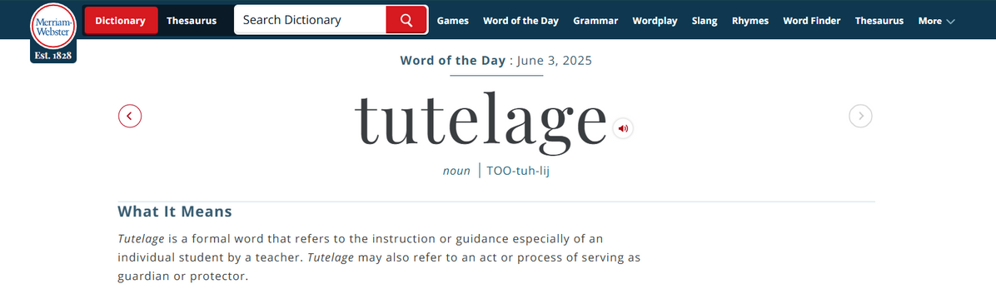
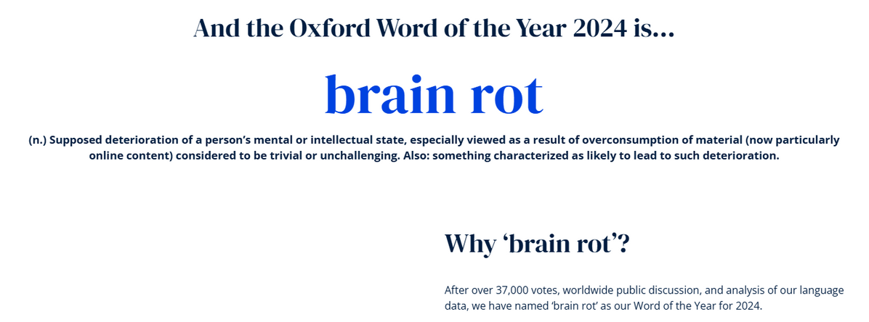
BACKGROUND

Slide 3
PROJECT GOALS
Generate trending words of the day based on current news and social media analysis
Capture trends of word/phrase usage in news media and social media
Generate a word of the year based on news and social media analysis along with public voting

Slide 4
DEMO

Slide 5
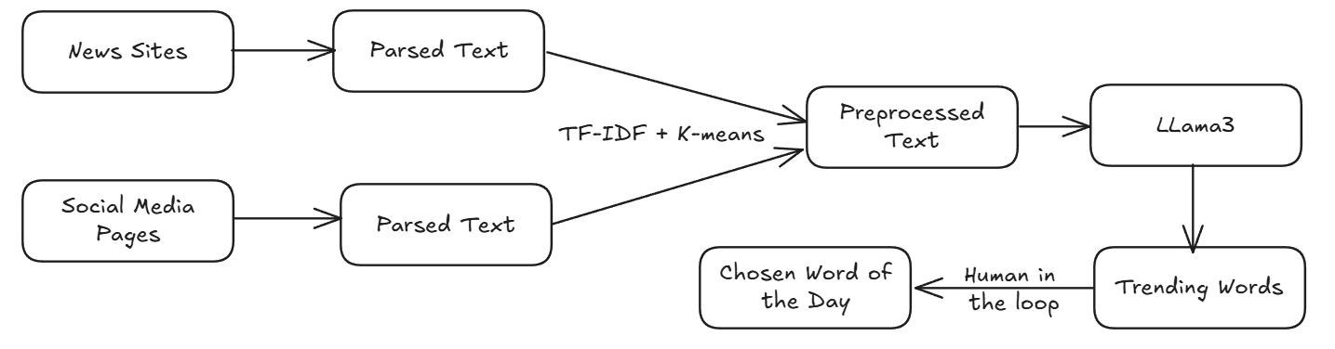
FEATURE FLOW

Slide 6
PLANNED IMPROVEMENTS
Increase the amount of input data
Graphs/charts to visualize trends
Model trials

Slide 7
THANK YOU

